Slide 1

Selecting/Deselecting Aggregate Bins
5.24.24 version 1.0

Slide 2
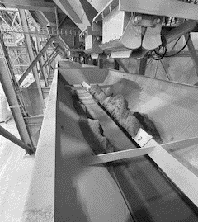
Assumptions and Prerequisite Skills
The computer is on and IntelliBatch 3.0 is open
Supplies Needed
Standard PPE

Slide 3
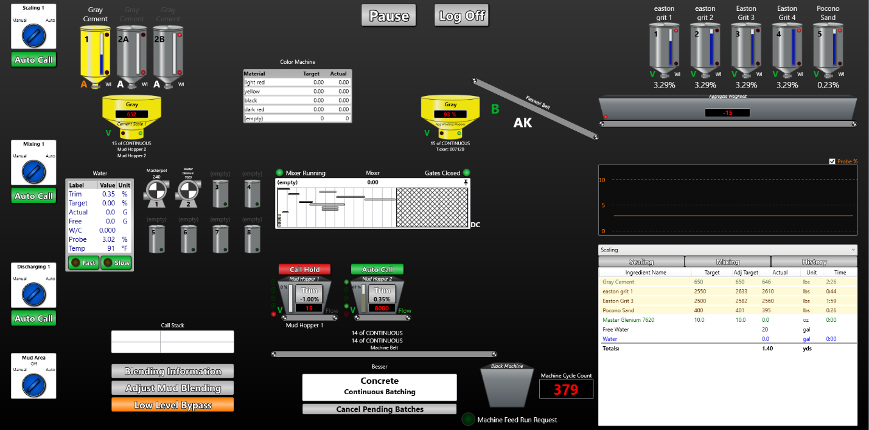
1. Go to the computer and click on “Concrete: Continuous Batching” button (see red circle Figure 1). This will take you to the “Mix Design List” page.
Figure 1

Slide 4
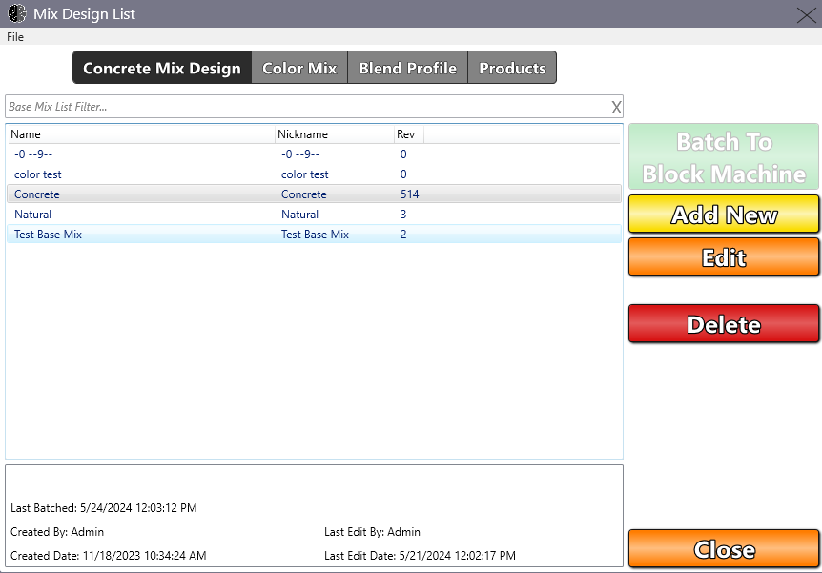
2. Click on the “Edit” button (see blue circle on Figure 2). This will take you to the “Concrete Mix Design Editor - Concrete” page.
Figure 2

Slide 5
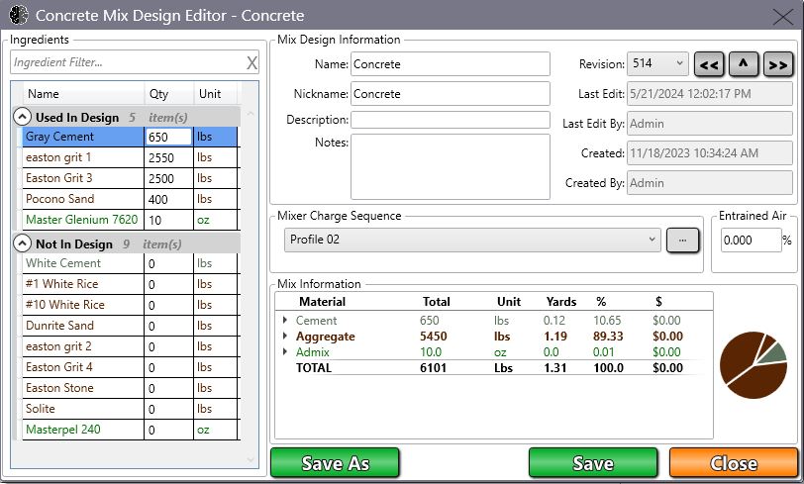
On the left-hand side of the page, you will see a label chart with the label “Used in Design” at the top. There, you will see at least one label called “Easton grit (1-5)” with values next to them (See the top yellow circle in Figure 3). Click the numbered value on whichever one you wish to deselect, give it a value of 0, and hit the enter key. This will take the item to the “Not in Design” category.
Under the “Not in Design” chart, you will see the other bins along with the bin(s) that you just entered 0 on (See the bottom yellow circle in Figure 3). Give a value of 2500 and for the other, give a value of 2580 (For example: If Bins 2 and 4 are empty, “Easton Grit 1” would be given 2500 and “Easton Grit 3” would be given 2580). These values represent the weight of aggregate that will be ejected onto the weighbelt whenever it is time for a new batch.
Figure 3

Slide 6
5. Double check the correct aggregate values have been inputted. Once this is confirmed, click “Save” once you are finished.
6. Click “Close” to go back to the “Main View” page.

